Slide 1
Organisation, Governance and Methodology
Oxford University
Software Engineering Programme
April 2021

Slide 2
Contents
Software Development Lifecycle
Registries
Design Governance
Runtime Governance

Slide 3

Before SOA

Slide 4

With SOA

Slide 5
SOA has an impact on organization
Refactoring of fiefdoms: – backend departments – cross-domain departments – frontend departments – “solutions managers”
Requires collaboration and trust
May change the funding model
That will pull in resistance

Slide 6

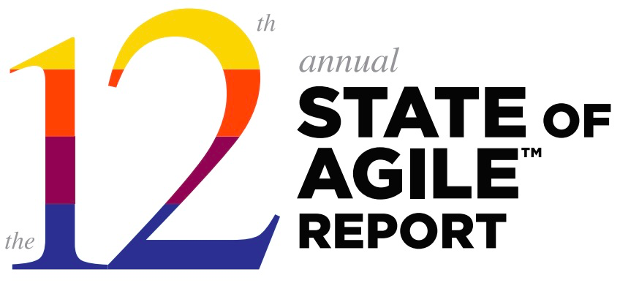

Slide 7


Slide 8

Developer Flow

Slide 9

The wrong organization interrupts flow

Slide 10


Slide 11


Slide 12

Complex processes interrupt flow
SGMM
SOA
Governance
Planning
Assessment
SOA
Governance
Capabilities
Heat Map
SOA
Governance
Transition
Plan
Step 1 Step 1 Step 1
Step 2 Step 2 Step 2
… … …
Step n Step p Step q
SOA
Governance
Assets
Governance Process
Models
Techniques, Checklist, Guidance, Examples

Slide 13
The Agile Manifesto
The best architectures, requirements, and designs emerge from self-organizing teams.
Agile processes promote sustainable development. The sponsors, developers, and users should be able to maintain a constant pace indefinitely.
Deliver working software frequently with a preference to the shorter timescale.

Slide 14
What is a “self-organizing” team?
A team which:
Manages its own work
Pulls work
Doesn’t require “command and control”
Communicates effectively with each other
Is not afraid to ask questions
Continuously evolves skills and capabilities
https://www.scrumalliance.org/community/articles/2013/january/self-organizing-teams-what-and-how

Slide 15

Self Organizing Teams

Slide 16


Slide 17



Slide 18
Conway’s Law
Any organization that designs a system will inevitably produce a design whose structure is a copy of the organization’s communication structure.
Melvin Conway,
How Do Committees Invent?,
Datamation Apr 1968, http://www.melconway.com/law/
Popularized and named by Fred Brooks in
The Mythical Man-Month
Eric Raymond:
“If you have four groups working on a compiler, you’ll get a 4-pass compiler.”

Slide 19

Reference Methodology https://github.com/wso2/reference-methodology

Slide 20
High level governance
Visions, objectives, business case, funding model
Why are we doing this? How will we pay for it?
Reference architecture Fundamental decisions: preferred technology, message exchange patterns, metamodel, etc
Rules and responsibilities
who drives and cares about issues
Policies, standards, formats, processes, lifecycles
decide and document, in standard notations

Slide 21
Technical Governance
Documentation
important for transparency; promotes non-technical issues
Service management
repositories and registries for services and contracts
Monitoring
conformance to policies, meeting SLAs, preparing for withdrawal
Change and configuration management
Code lifecycle, DevOps, SOA, the intersection

Slide 22
Establishing a services approach
Developer-driven, grass-roots
leads to technological experience; likely to be uncoordinated
Business-driven
proof of concept helps adoption; limited benefit from early projects
IT-driven
effective for infrastructure; focus on technical aspects
Management-driven
top-down coordinated, driven by business priorities; expensive, disruptive, risky

Slide 23
“Shift to the Left”
Start each project with:
Git / SCM
Build / Test
DevOps
Cloud Orchestration
Observability
GitOps
etc
Then start writing code…

Slide 24
Questions?

